Slide 1
Users Experience
By: Kshitiz Srivastava

Slide 2
What is User Experience?
The user experience is how a user interacts with and experiences a product, system or service. It includes a person's perceptions of utility, ease of use, and efficiency.

Slide 3
Difference Between UI and UX
UI refers to the screens, buttons, toggles, icons, and other visual elements that you interact with when using a website, app, or other electronic device.
UX refers to the entire interaction you have with a product, including how you feel about the interaction.

Slide 4


Slide 5


Slide 6
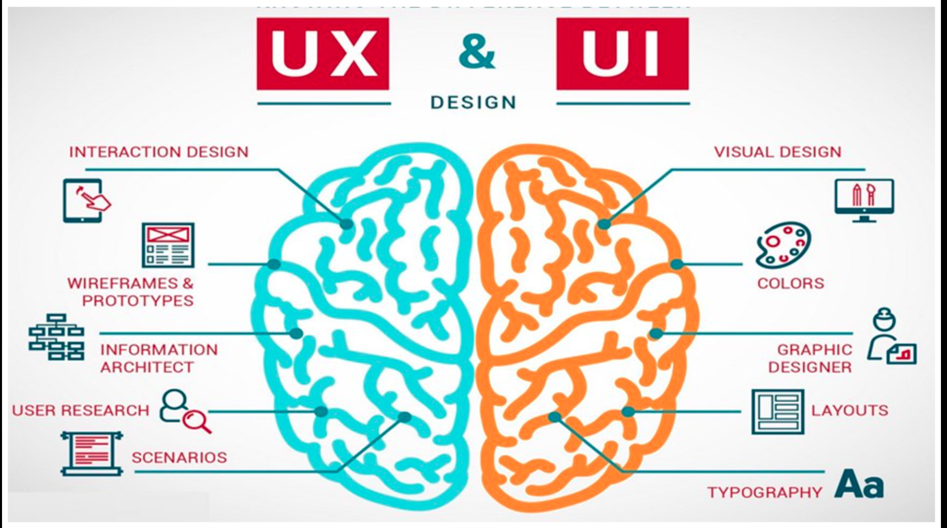

Slide 7
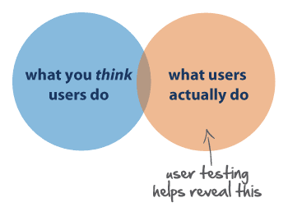
UX principles
1. Meet The Users Need

Slide 8
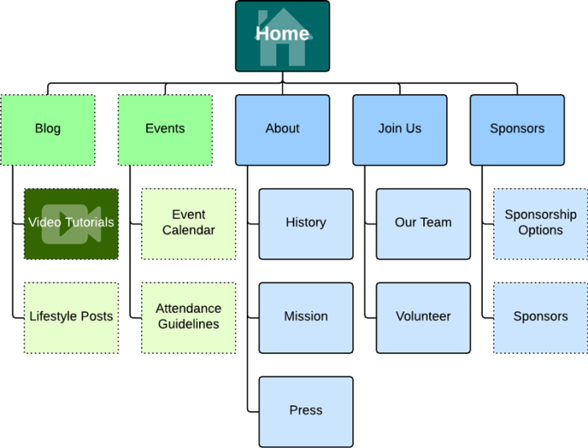
UX principles
2. Have a clear hierarchy

Slide 9

UX principles
3. Keep it consistent

Slide 10

UX principles
4. Understand accessibility

Slide 11
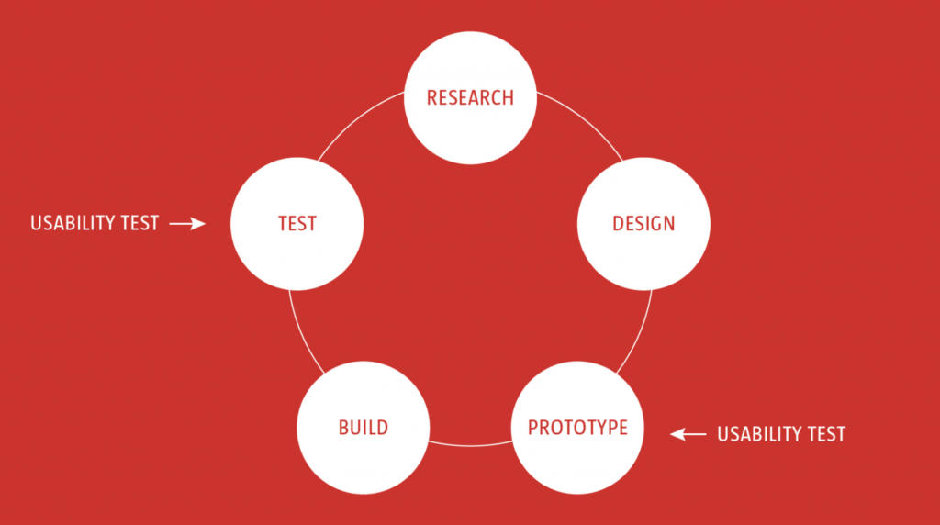
UX principles
5. Usability first

Slide 12

UX principles
6. Less is more

Slide 13
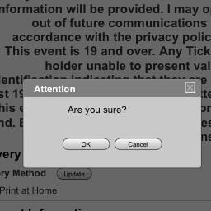
UX principles
7. Use simple language

Slide 14

UX principles
8. Typography is powerful

Slide 15
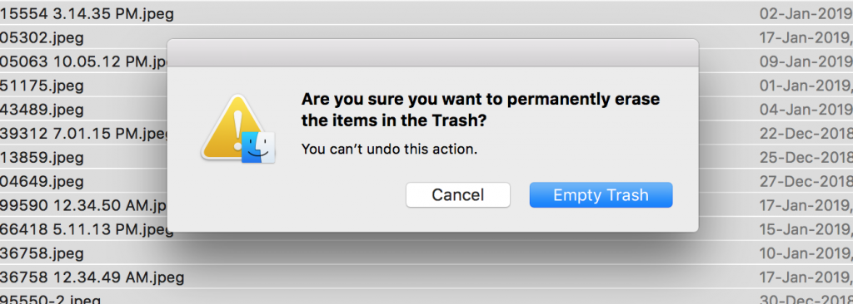
UX principles
9. Confirm before you commit

Slide 16

UX principles
10. Design with personality

Slide 17

UX principles
11. Narrative design

Slide 18
THANKU

